Slide 1
Discrete Mathematics
Dr. Han Huang
South China University of Technology
1

Slide 2
Chapter 1. Logic and Proof, Sets, and Function
Propositional Equivalence
Section 1.2
2

Slide 3
Contents
1
Tautology and Contradiction
2
Proofs with Truth Value Table
3
Proofs of Logical Equivalences
3
3

Slide 4
Tautology and Contradiction
4
4

Slide 5
Tautologies
A tautology is a compound proposition that is true no matter what the truth values of its atomic propositions are!
Ex. p ∨ ¬p [What is its truth table?]
5
5

Slide 6
Tautologies
6
6
When each row of the truth table gives T.
Example: p ∨ ¬p T ¬ F=T F ¬ T=F
T

Slide 7
Contradictions
7
7
A contradiction is a compound proposition that is false no matter what!
Ex. p ∧ ¬p [Truth table?]

Slide 8
Contradictions
8
8
When each row of the truth table gives F
Example: p ∧ ¬p T ¬ F=T F ¬ T=F
F

Slide 9
Proofs with Truth
Value Table
9
9

Slide 10
Propositional Equivalence
10
10
Two syntactically (i.e., textually) different compound propositions may be semantically identical (i.e., have the same meaning). We call them logically equivalent.
Notation: … ⇔ …

Slide 11
Logical Equivalence
11
11
Compound proposition p is logically equivalent to compound proposition q, written p⇔q, IFF p and q contain the same truth values in all rows of their truth tables
We will also say: they express the same truth function (= the same function from values for atoms to values for the whole formula).

Slide 12
Example 2
F
T
T
T
F
T
T
F
F
T
T
F
T
F
T
T
F
F
F
T
12
12
Ex. Prove that p∨q ⇔ ¬(¬p ∧ ¬q).

Slide 13
Example 3
T
T
T
T
T
T
F
F
F
F
T
T
13
13
Ex. Prove that ¬ p∨q ⇔ p → q.

Slide 14
Example 4
T
T
T
T
T
F
T
T
T
T
T
T
T
T
T
F
T
T
T
T
F
T
T
T
T
F
F
T
F
F
F
F
F
T
F
F
F
F
F
F
14
14
Ex. Prove that p ∨ (q ∧ r)⇔ (p ∨ q) ∧ (p ∨ r) .

Slide 15
Questions for you to think about
15
15
Consider a conjunction p₁ ∧ p₂ ∧ p₃ How many rows are there in its truth table?
Consider a conjunction p₁ ∧ p₂ ∧ … ∧ p_{n} of n propositions. How many rows are there in its truth table?
Explain why ¬ and ∧ together are sufficient to express any Boolean truth table
Notes:
15
Note that AND is commutative and associative, which means that we can write a long conjunction (like in the first bullet on the left) without parenthesizing it. It also doesn’t matter what order the n propositions are in.
The fact that an n-operand operator has 2^n rows in its truth table is an easy consequence of the product rule of combinatorics. Here is a proof. Note that for the table to be complete, we must have 1 row for every possible assignment of truth values to the n operands. Thus, there is 1 row for every function f:V->B, where V is the set of operand columns {p,q,…} and B={T,F}. Here, |V|=n and |B|=2. The number of functions from a set of size n to a set of size m is m^n. This is because of the product rule, as we will see in a moment. In this case, m=2 so we get 2^n such functions. In terms of the product rule: There are 2 possible values for p. For each of these, there are 2 possible values for q, since the choice of q is independent of the choice of p. And so on. So there are 2x2x…(n repetitions)…x2 possible rows, thus 2^n. Of course, we haven’t defined the product rule, set cardinality, or functions yet, so don’t worry if the above argument doesn’t quite make sense to you yet.
In the second bullet, we would say, {NOT,AND} is a universal set of Boolean operators, but we haven’t even defined sets yet. If you already know what a set is, a universal set of operators over a given domain is a set of operators such that nested expressions involving those operators are sufficient to express any possible operator over that domain. In this case, the domain is B={T,F}. The proof that {NOT,AND} is universal is as follows: OR can be defined by p OR q = NOT(NOT(p) AND NOT(q)) (easily verified; this is one of DeMorgan’s Laws, which we will get to later). Now, armed with OR, AND, and NOT, we can show how to express any Boolean truth table, with any number of columns, as follows. Look for the cases where the last (result) column is T. For each such row in the truth table, include a corresponding term in a disjunctive expression for the whole truth table. The term should be a conjunction of terms, one for each input operand in that row. Each of these terms should be p if the entry in that position is “T”, and NOT(p) if the entry in that position is “F”. So, the entire expression basically says, “the value of the operator is T if and only if the pattern of truth values of the input operands exactly matches one of the rows in the truth table that ends in a ‘T’ result.” Thus, the expression directly encodes the content of the truth table.

Slide 16
Questions for you to think about
16
16
Consider a conjunction p₁ ∧ p₂ ∧ p₃ How many rows are there in its truth table? 8 p₁ ∧ p₂ ∧ p₃ 1 1 1 1 1 0 1 0 1 1 0 0 0 1 1 0 1 0 0 0 1 0 0 0
Notes:
16
Note that AND is commutative and associative, which means that we can write a long conjunction (like in the first bullet on the left) without parenthesizing it. It also doesn’t matter what order the n propositions are in.
The fact that an n-operand operator has 2^n rows in its truth table is an easy consequence of the product rule of combinatorics. Here is a proof. Note that for the table to be complete, we must have 1 row for every possible assignment of truth values to the n operands. Thus, there is 1 row for every function f:V->B, where V is the set of operand columns {p,q,…} and B={T,F}. Here, |V|=n and |B|=2. The number of functions from a set of size n to a set of size m is m^n. This is because of the product rule, as we will see in a moment. In this case, m=2 so we get 2^n such functions. In terms of the product rule: There are 2 possible values for p. For each of these, there are 2 possible values for q, since the choice of q is independent of the choice of p. And so on. So there are 2x2x…(n repetitions)…x2 possible rows, thus 2^n. Of course, we haven’t defined the product rule, set cardinality, or functions yet, so don’t worry if the above argument doesn’t quite make sense to you yet.
In the second bullet, we would say, {NOT,AND} is a universal set of Boolean operators, but we haven’t even defined sets yet. If you already know what a set is, a universal set of operators over a given domain is a set of operators such that nested expressions involving those operators are sufficient to express any possible operator over that domain. In this case, the domain is B={T,F}. The proof that {NOT,AND} is universal is as follows: OR can be defined by p OR q = NOT(NOT(p) AND NOT(q)) (easily verified; this is one of DeMorgan’s Laws, which we will get to later). Now, armed with OR, AND, and NOT, we can show how to express any Boolean truth table, with any number of columns, as follows. Look for the cases where the last (result) column is T. For each such row in the truth table, include a corresponding term in a disjunctive expression for the whole truth table. The term should be a conjunction of terms, one for each input operand in that row. Each of these terms should be p if the entry in that position is “T”, and NOT(p) if the entry in that position is “F”. So, the entire expression basically says, “the value of the operator is T if and only if the pattern of truth values of the input operands exactly matches one of the rows in the truth table that ends in a ‘T’ result.” Thus, the expression directly encodes the content of the truth table.

Slide 17
Questions for you to think about
17
17
2. Consider p₁ ∧ p₂ ∧ … ∧ p_{n} How many rows are there in its truth table? 2.2.2. … .2 (n factors) Hence 2^{n} (This grows exponentially!)
Notes:
17
Note that AND is commutative and associative, which means that we can write a long conjunction (like in the first bullet on the left) without parenthesizing it. It also doesn’t matter what order the n propositions are in.
The fact that an n-operand operator has 2^n rows in its truth table is an easy consequence of the product rule of combinatorics. Here is a proof. Note that for the table to be complete, we must have 1 row for every possible assignment of truth values to the n operands. Thus, there is 1 row for every function f:V->B, where V is the set of operand columns {p,q,…} and B={T,F}. Here, |V|=n and |B|=2. The number of functions from a set of size n to a set of size m is m^n. This is because of the product rule, as we will see in a moment. In this case, m=2 so we get 2^n such functions. In terms of the product rule: There are 2 possible values for p. For each of these, there are 2 possible values for q, since the choice of q is independent of the choice of p. And so on. So there are 2x2x…(n repetitions)…x2 possible rows, thus 2^n. Of course, we haven’t defined the product rule, set cardinality, or functions yet, so don’t worry if the above argument doesn’t quite make sense to you yet.
In the second bullet, we would say, {NOT,AND} is a universal set of Boolean operators, but we haven’t even defined sets yet. If you already know what a set is, a universal set of operators over a given domain is a set of operators such that nested expressions involving those operators are sufficient to express any possible operator over that domain. In this case, the domain is B={T,F}. The proof that {NOT,AND} is universal is as follows: OR can be defined by p OR q = NOT(NOT(p) AND NOT(q)) (easily verified; this is one of DeMorgan’s Laws, which we will get to later). Now, armed with OR, AND, and NOT, we can show how to express any Boolean truth table, with any number of columns, as follows. Look for the cases where the last (result) column is T. For each such row in the truth table, include a corresponding term in a disjunctive expression for the whole truth table. The term should be a conjunction of terms, one for each input operand in that row. Each of these terms should be p if the entry in that position is “T”, and NOT(p) if the entry in that position is “F”. So, the entire expression basically says, “the value of the operator is T if and only if the pattern of truth values of the input operands exactly matches one of the rows in the truth table that ends in a ‘T’ result.” Thus, the expression directly encodes the content of the truth table.

Slide 18
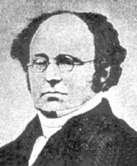
De Morgan’s laws
¬(p1 ∨ p2… ∨ pn)= ¬p1 ∧ ¬ p2… ∧ ¬ pn
¬(p1 ∧ p2… ∧ pn)= ¬p1 ∨ ¬ p2… ∨ ¬ pn
¬(p ∨ q)= ¬ p ∧ ¬ q
¬(p ∧ q)= ¬ p ∨ ¬ q
Augustus De Morgan (1806-1871)
18
18

Slide 19
Truth Table for De Morgan’s Law
19
19

Slide 20
Equivalence Laws - Examples
20
20
Identity: p∧T ⇔ p p∨F ⇔ p
Domination: p∨T ⇔ T p∧F ⇔ F
Idempotence: p∨p ⇔ p p∧p ⇔ p
Double negation: ¬¬p ⇔ p
Commutativity: p∨q ⇔ q∨p p∧q ⇔ q∧p
Associativity: (p∨q)∨r ⇔ p∨(q∨r) (p∧q)∧r ⇔ p∧(q∧r)

Slide 21
More Equivalence Laws
Augustus De Morgan (1806-1871)
21
21
Distributive: p∨(q∧r) ⇔ (p∨q)∧(p∨r) p∧(q∨r) ⇔ (p∧q)∨(p∧r)
De Morgan’s: ¬(p∧q) ⇔ ¬p ∨ ¬q ¬(p∨q) ⇔ ¬p ∧ ¬q
Trivial tautology/contradiction: p ∨ ¬p ⇔ T p ∧ ¬p ⇔ F

Slide 22
Logical Equivalence Involving Implications
22
22
p → q ⇔ ¬p ∨ q p → q ⇔ ¬q → ¬p
p ∨ q ⇔ ¬p → q p ∧ q ⇔ ¬(p → ¬q)
¬(p → q) ⇔ p ∧ ¬ q
(p → q) ∧ (p → r) ⇔ p → (q ∧ r)
(p → r) ∧ (q → r) ⇔ (p ∨ q) → r
(p → q) ∨ (p → r) ⇔ p → (q ∨ r)
(p → r) ∨ (q → r) ⇔ (p ∧ q) → r

Slide 23
(p → q) ∧ (p → r) ⇔ p → (q ∧ r)
23
(p → q) ∧ (p → r)
⇔ (¬ p ∨ q) ∧ (¬ p ∨ r)
⇔ ¬ p ∨ (q ∧ r )
⇔ p → (q ∧ r)
Distributive: p∨(q∧r) ⇔ (p∨q)∧(p∨r) p∧(q∨r) ⇔ (p∧q)∨(p∧r)

Slide 24
(p → r) ∧ (q → r) ⇔ (p ∨ q) → r
24
(p → r) ∧ (q → r)
⇔ (¬ p ∨ r) ∧ (¬ q ∨ r)
⇔ r ∨ (¬ p ∧ ¬ q )
⇔ r ∨ ¬ (p ∨ q )
⇔ ¬ (p ∨ q ) ∨ r
⇔ (p ∨ q) → r
Distributive

Slide 25
(p → q) ∨ (p → r) ⇔ p → (q ∨ r)
25
(p → q) ∨ (p → r)
⇔ (¬ p ∨ q) ∨ (¬ p ∨ r)
⇔ ¬ p ∨ (q ∨ r)
⇔ p → (q ∨ r)
Distributive

Slide 26
(p → r) ∨ (q → r) ⇔ (p ∧ q) → r
26
(p → r) ∨ (q → r)
⇔ (¬ p ∨ r) ∨ (¬ q ∨ r)
⇔ r ∨ (¬ p ∨ ¬ q )
⇔ r ∨ ¬ (p ∧ q )
⇔ ¬ (p ∧ q ) ∨ r
⇔ (p ∧ q) → r

Slide 27
Logical Equivalence Involving Biconditionals
27
27
p ↔ q ⇔ (p → q) ∧ (q → p)
p ↔ q ⇔ ¬ p ↔ ¬ q
p ↔ q ⇔ (p ∧ q) ∨ (¬ p ∧ ¬ q)
¬ (p ↔ q) ⇔ p ↔ ¬ q

Slide 28
p ↔ q ⇔ (p → q) ∧ (q → p)
28
(p → q) ∧ (q → p)
⇔ (¬ p ∨ q) ∧ (¬ q ∨ p)
= T if p=q or F if p and q are different
So (¬ p ∨ q) ∧ (¬ q ∨ p) ⇔ p ↔ q

Slide 29
p ↔ q ⇔ ¬ p ↔ ¬ q
29
¬ p ↔ ¬ q
⇔ (¬ p → ¬ q) ∧ (¬ q → ¬ p)
⇔ (¬ ¬ p ∨ ¬ q) ∧ (¬ ¬ q ∨ ¬ p)
⇔ ( p ∨ ¬ q) ∧ (q ∨ ¬ p)
⇔ (¬ q ∨ p) ∧ (¬ p ∨ q)
⇔ (q → p) ∧ (p → q)
⇔ p ↔ q

Slide 30
p ↔ q ⇔ (p ∧ q) ∨ (¬ p ∧ ¬ q)
p ↔ q
⇔ (p → q) ∧ (q → p)
⇔ (¬ p ∨ q) ∧ (¬ q ∨ p)
⇔ ((¬ p ∨ q) ∧ ¬ q ) ∨ ((¬ p ∨ q) ∧ p )
⇔ (¬p∧¬q)∨(q ∧¬q)∨ (¬p∧p)∨(q ∧ p)
⇔ (¬p ∧ ¬q) ∨ F ∨ F ∨ (q ∧ p)
⇔ (q ∧ p) ∨(¬p ∧ ¬q)
The first approach of Proof
30

Slide 31
p ↔ q ⇔ (p ∧ q) ∨ (¬ p ∧ ¬ q)
p ↔ q
⇔ (p → q) ∧ (q → p)
⇔ (¬ p ∨ q) ∧ (¬ q ∨ p)
⇔ ((¬ p ∨ q) ∧ T ) ∧ ((¬ q ∨ p) ∧ T )
⇔ (¬p ∨ q)∧(¬ p ∨ p) ∧ (¬q ∨ p) ∧ (¬q ∨ q)
⇔ (¬p ∨ (p ∧ q)) ∧ (¬q ∨ (p ∧ q))
⇔ (q ∧ p) ∨(¬p ∧ ¬q)
The second approach of Proof
31

Slide 32
¬ (p ↔ q) ⇔ p ↔ ¬ q
¬ (p ↔ q)
⇔ ¬((q ∧ p) ∨(¬p ∧ ¬q))
⇔ ¬(q ∧ p) ∧ ¬ (¬p ∧ ¬q)
⇔ (¬q ∨ ¬p) ∧ (p ∨ q)
⇔ (¬p ∨ ¬q) ∧ (q ∨ p)
⇔ (p → ¬q) ∧ (¬q → p)
⇔ p ↔ ¬q
32

Slide 33
Defining Operators via Equivalences
33
33
Some equivalences can be thought as definitions of one operator in terms of others:
Exclusive or: p⊕q ⇔ (p∨q)∧¬(p∧q) p⊕q ⇔ (p∧¬q)∨(q∧¬p)
Implies: p→q ⇔ ¬p ∨ q
Biconditional: p↔q ⇔ (p→q) ∧ (q→p) p↔q ⇔ ¬(p⊕q)

Slide 34
p ⊕ q ⇔ (p ∨ q) ∧ ¬( p ∧ q )
34
p ⊕ q
⇔ ¬ (p ↔ q)
⇔ ¬((q ∧ p) ∨(¬p ∧ ¬q))
⇔ ¬(q ∧ p) ∧ ¬ (¬p ∧ ¬q)
⇔ (¬q ∨ ¬ p) ∧ (p ∨ q)
⇔ ¬ (q ∧ p) ∧ (p ∨ q)
⇔ (p ∨ q) ∧ ¬ (q ∧ p)

Slide 35
p ⊕ q ⇔ ( p ∧ ¬q )∨( q ∧ ¬p)
35
( p ∧¬ q ) ∨ ( q ∧ ¬p )
⇔ ¬ (¬ (( p ∧¬ q ) ∨ ( q ∧ ¬p )))
⇔ ¬ (¬ ( p ∧¬ q ) ∧ ¬ ( q ∧ ¬p ))
⇔ ¬ ((¬ p ∨ q) ∧ (¬q ∨ p))
⇔ ¬ ((p → q) ∧ (q → p))
⇔ ¬ (p ↔ q)
⇔ p ⊕ q

Slide 36
Example 1
36
¬(p ∨ (¬p ∧ q)) ⇔ ¬p ∧ ¬q ?
¬(p ∨ (¬p ∧ q))
⇔ ¬p ∧ ¬(¬p ∧ q)
⇔ ¬p ∧ ( p ∨ ¬ q )
⇔ ¬p ∧ p ∨ ¬p ∧ ¬ q
⇔ F ∨ ¬p ∧ ¬ q
⇔ ¬p ∧ ¬ q

Slide 37
Example 2
37
( p ∧ q ) → p ∨ q ⇔ T
( p ∧ q ) → p ∨ q
⇔ ¬ (p ∧ q) ∨ (p ∨ q)
⇔ (¬ p ∨ ¬ q) ∨ (p ∨ q)
⇔ ¬ p ∨ ¬ q ∨ p ∨ q
⇔ ¬ p ∨ p ∨ ¬ q ∨ q
⇔ T ∨ T
⇔ T

Slide 38
Example 3
38
38
Use equivalences to prove that (p ∧ ¬q) → (p ⊕ r) ⇔ ¬p ∨ q ∨ ¬r.
(This would be much easier using truth tables!)
(p ∧ ¬q) → (p ⊕ r) [Expand “definition” of →]
⇔ ¬(p ∧ ¬q) ∨ (p ⊕ r) [Expand “definition” of ⊕]
⇔ ¬(p ∧ ¬q) ∨ ((p ∨ r) ∧ ¬(p ∧ r)) [DeMorgan]
⇔ (¬p ∨ q) ∨ ((p ∨ r) ∧ ¬(p ∧ r))
cont.

Slide 39
Long example Continued...
39
39
(¬p ∨ q) ∨ ((p ∨ r) ∧ ¬(p ∧ r)) ⇔ [∨ commutes]
⇔ (q ∨ ¬p) ∨ ((p ∨ r) ∧ ¬(p ∧ r)) [∨ is associative]
⇔ q ∨ (¬p ∨ ((p ∨ r) ∧ ¬(p ∧ r))) [distrib. ∨ over ∧]
q ∨ (((¬p ∨ (p ∨ r)) ∧ (¬p ∨ ¬(p ∧ r))) [assoc.]
q ∨ (((¬p ∨ p) ∨ r) ∧ (¬p ∨ ¬(p ∧ r))) [taut.]
q ∨ ((T ∨ r) ∧ (¬p ∨ ¬(p ∧ r))) [domination]
q ∨ (T ∧ (¬p ∨ ¬(p ∧ r))) [identity]
⇔ q ∨ (¬p ∨ ¬(p ∧ r)) ⇔ cont.

Slide 40
End of Long Example
40
40
q ∨ (¬p ∨ ¬(p ∧ r)) [DeMorgan]
q ∨ (¬p ∨ (¬p ∨ ¬r)) [Assoc.]
q ∨ ((¬p ∨ ¬p) ∨ ¬r) [Idempotent]
q ∨ (¬p ∨ ¬r) [Associativity]
(q ∨ ¬p) ∨ ¬r [Commutativity]
⇔ ¬p ∨ q ∨ ¬r

Slide 41
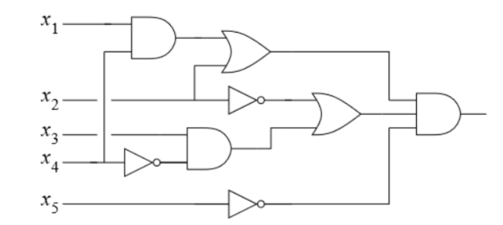
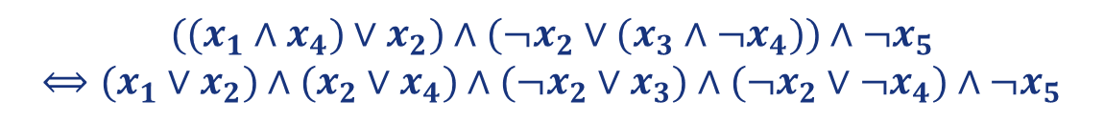
电路可满足性问题
给定一个电路，如果存在一组输入使得电路输出为TRUE，则称该电路是可满足的（satisfiable）。反之，当电路输出总是FALSE（Contradiction），则该电路是不可满足的（unsatisfiable）。
$$((x_{1}∧x_{4})∨x_{2})∧(¬x_{2}∨(x_{3}∧¬x_{4}))∧¬x_{5}$$
$⟺(x_{1}∨x_{2})∧(x_{2}∨x_{4})∧(¬x_{2}∨x_{3})∧(¬x_{2}∨¬x_{4})∧¬x_{5}$
存在输入（1,1,1,0,0）使得输出为True，因此该电路是可满足的。
41

Slide 42
Exercise
42

Slide 43
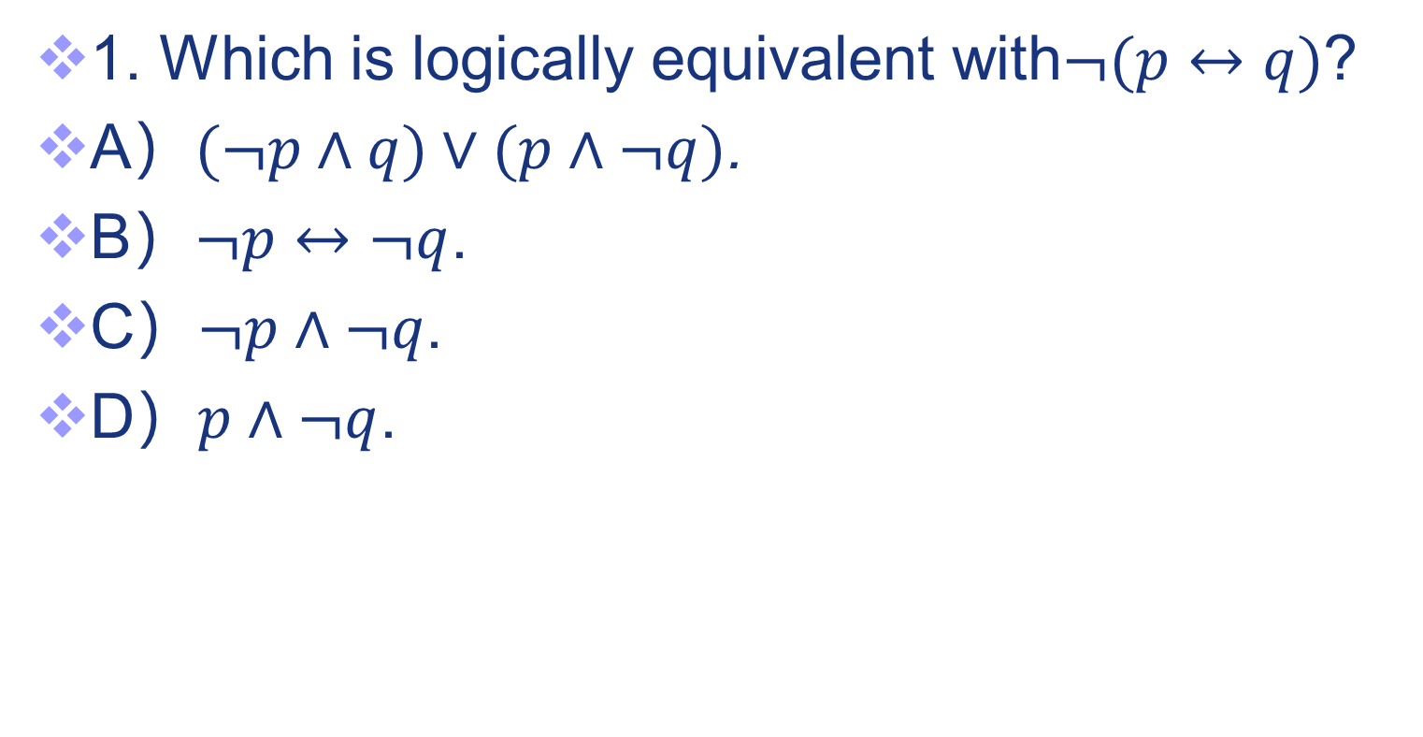
Exercises
43

Slide 44
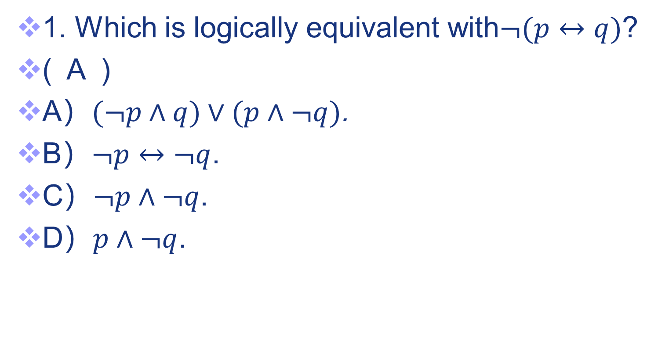
Exercises
44

Slide 45
Exercises
2. Which is logically equivalent to ¬ (p ∨ (¬ p ∧ q))?
a) ¬ p ∧¬ q
b) p ∨ ¬ q
c) ¬ p∧q
d) ¬ p∨¬ q
45

Slide 46
Exercises
2. Which is logically equivalent to ¬ (p ∨ (¬ p ∧ q))? ( A )
a) ¬ p ∧¬ q
b) p ∨ ¬ q
c) ¬ p∧q
d) ¬ p∨¬ q
46

Slide 47
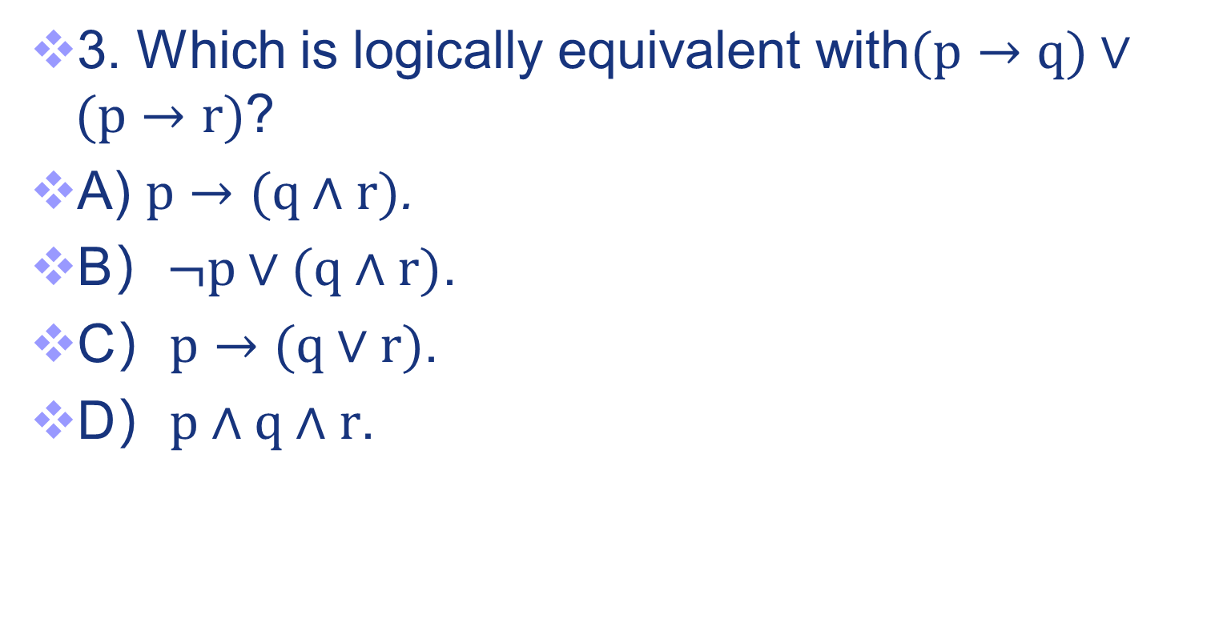
Exercises
47

Slide 48
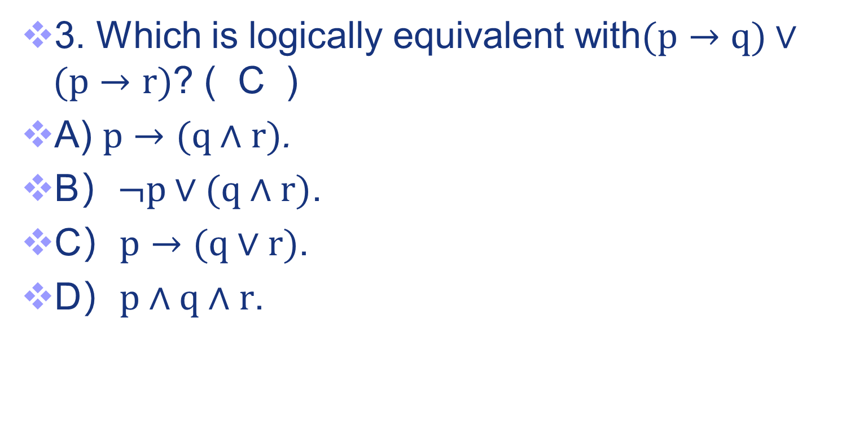
Exercises
48

Slide 49
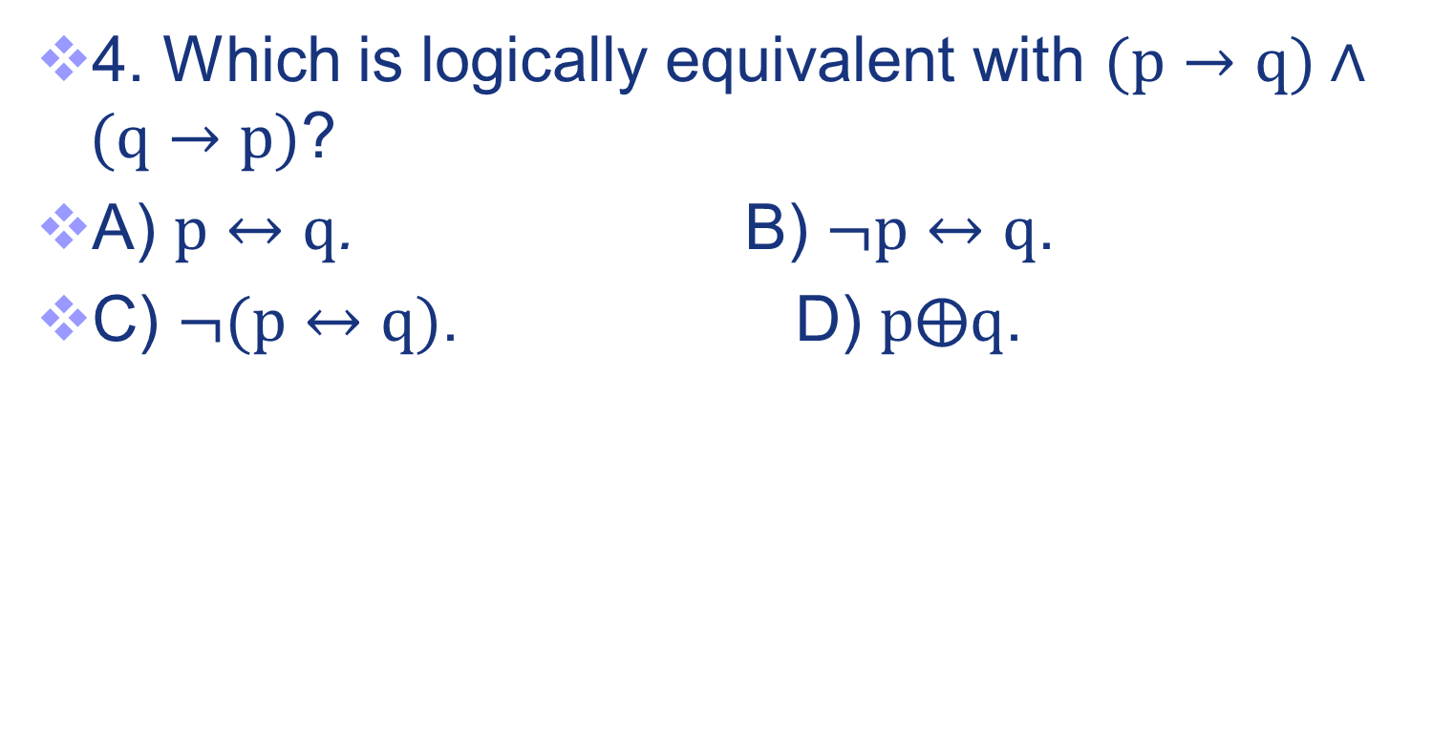
Exercises
49

Slide 50
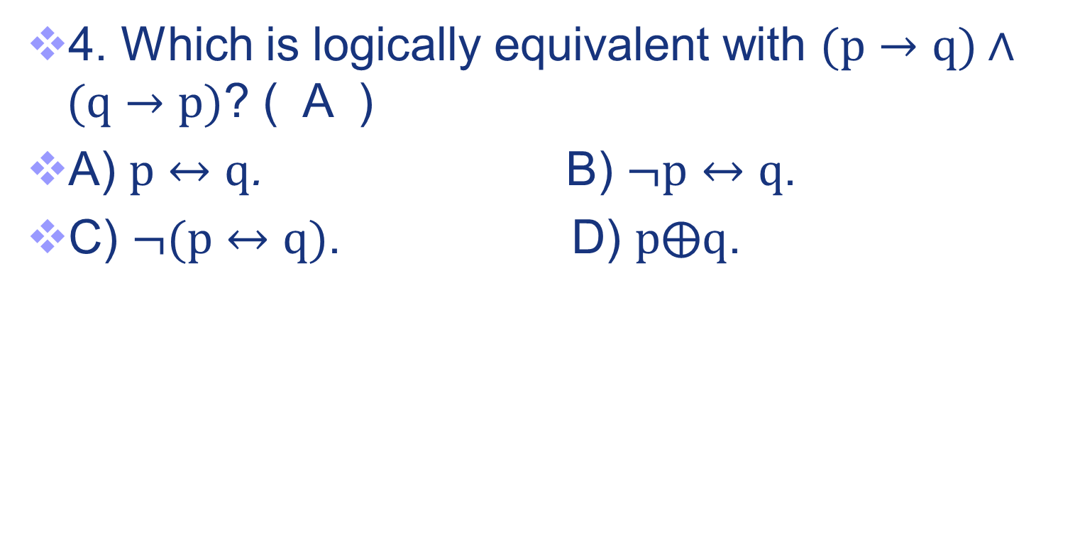
Exercises
50

Slide 51
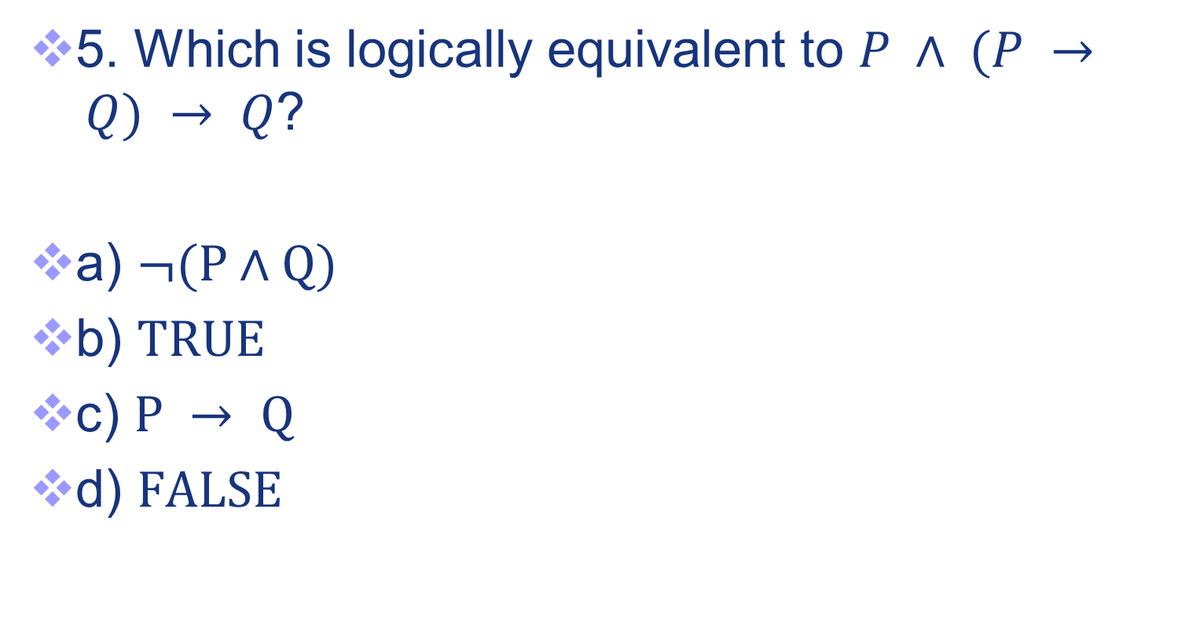
Exercises
5. Which is logically equivalent to $P ∧ (P → Q) → Q$?
a) $¬(P∧Q)$
b) $TRUE$
c) $P → Q$
d) $FALSE$
51

Slide 52
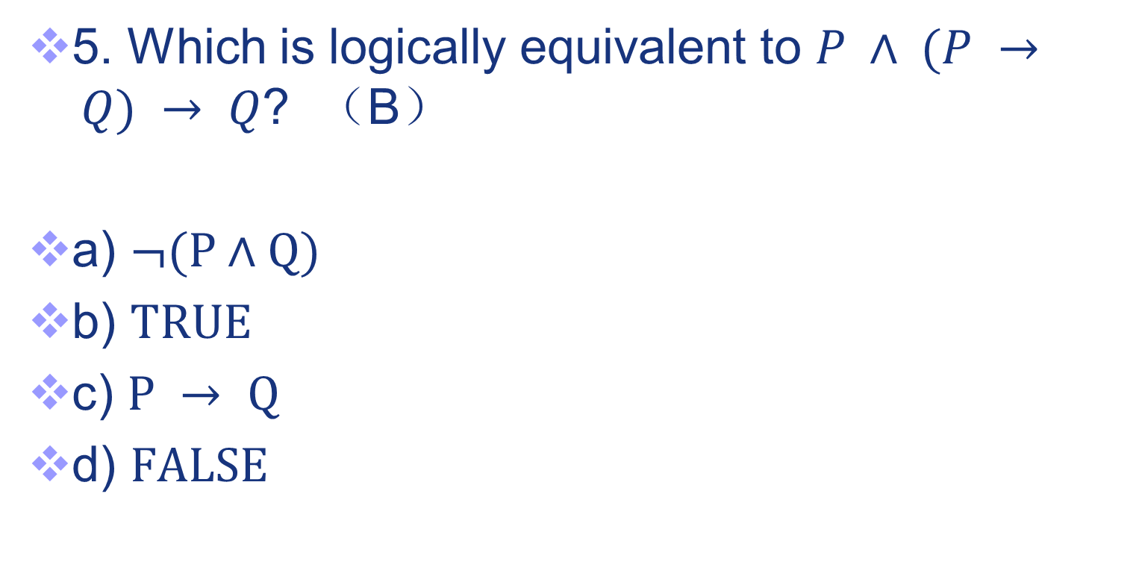
Exercises
5. Which is logically equivalent to $P ∧ (P → Q) → Q$? （B）
a) $¬(P∧Q)$
b) $TRUE$
c) $P → Q$
d) $FALSE$
52

Slide 53
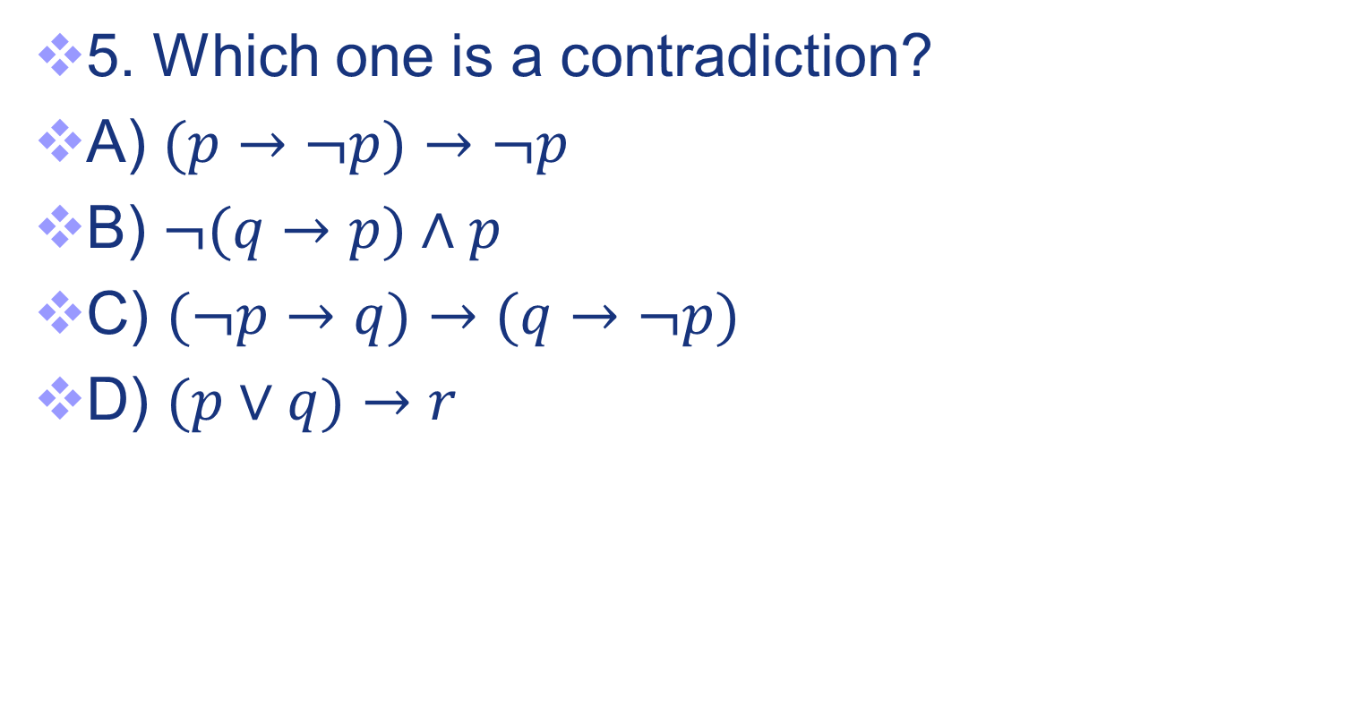
Exercises
6.
53

Slide 54
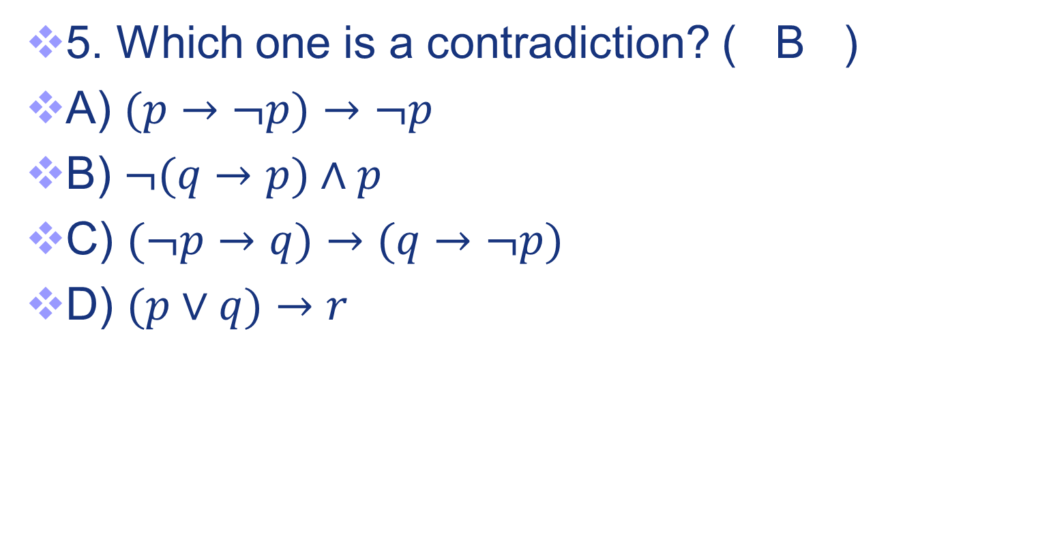
Exercises
6.
54

Slide 55
Exercises
7. The propositional formula P→(Q→P) is a/an
A. tautology
B. satisfactory form
C. contradictory formula
D. equation
55

Slide 56
Exercises
7. The propositional formula P→(Q→P) is a/an
(A)
A. tautology
B. satisfactory form
C. contradictory formula
D. equation
56

Slide 57
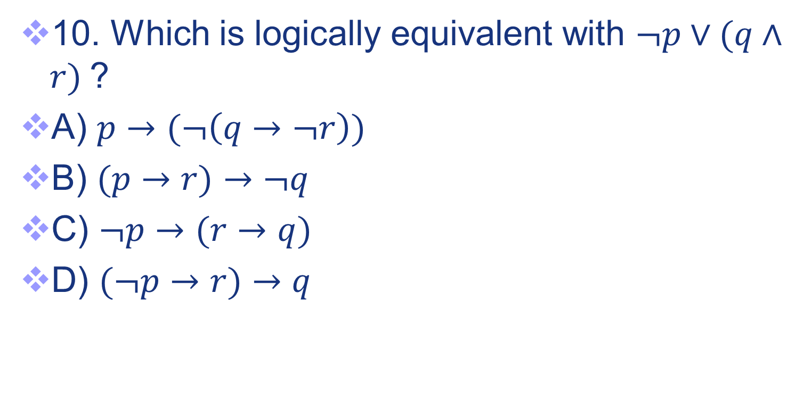
Exercises
8.
7.
57

Slide 58
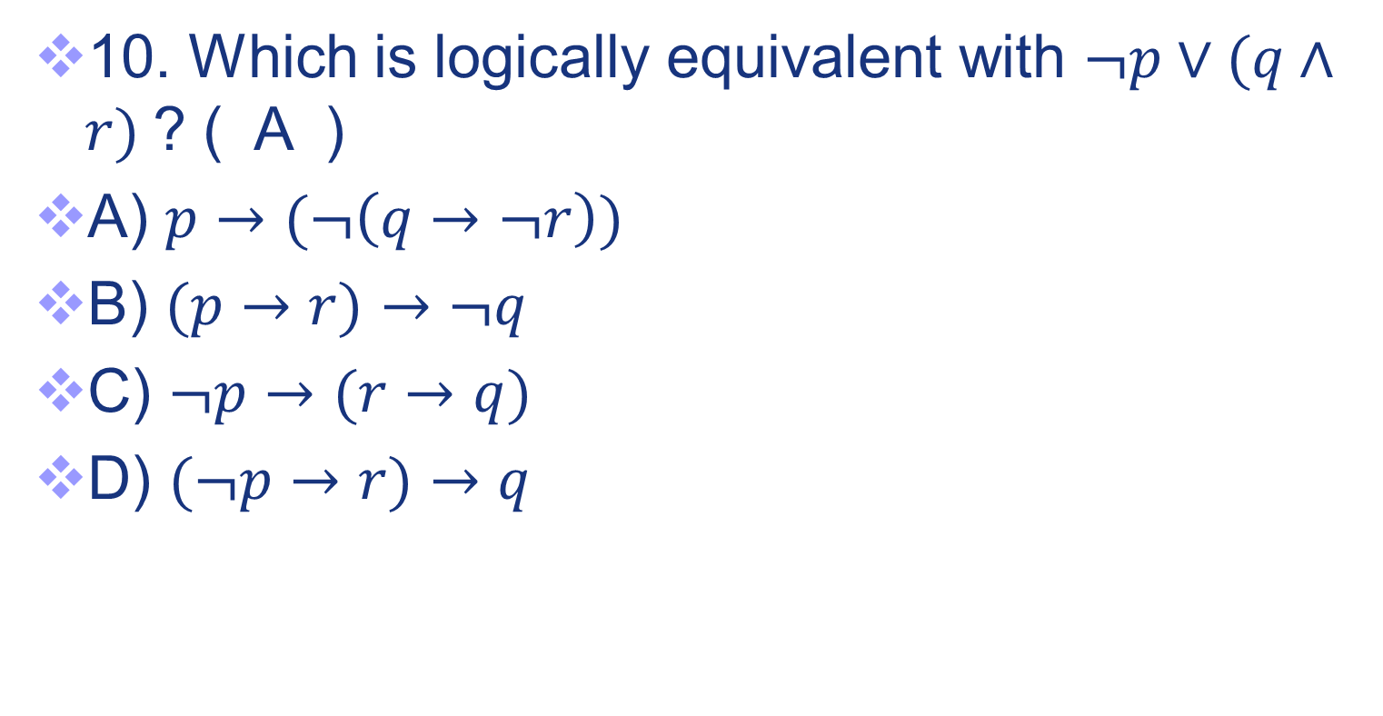
Exercises
8.
58

Slide 59
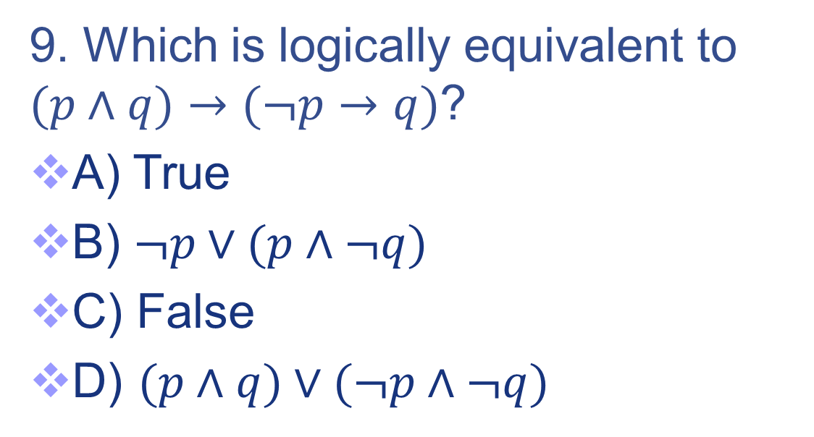
Exercises
9. Which is logically equivalent to
$(p∧q)→(¬p→q)$?
A) True
B) $¬p∨(p∧¬q)$
C) False
D) $(p∧q)∨(¬p∧¬q)$
59

Slide 60
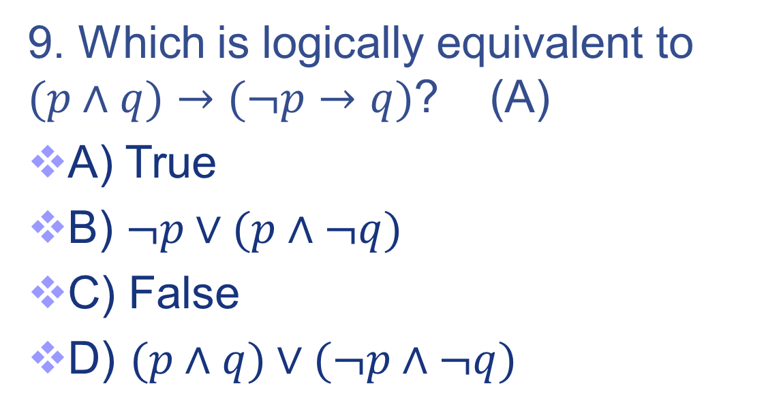
Exercises
9. Which is logically equivalent to
$(p∧q)→(¬p→q)$? (A)
A) True
B) $¬p∨(p∧¬q)$
C) False
D) $(p∧q)∨(¬p∧¬q)$
60

Slide 61
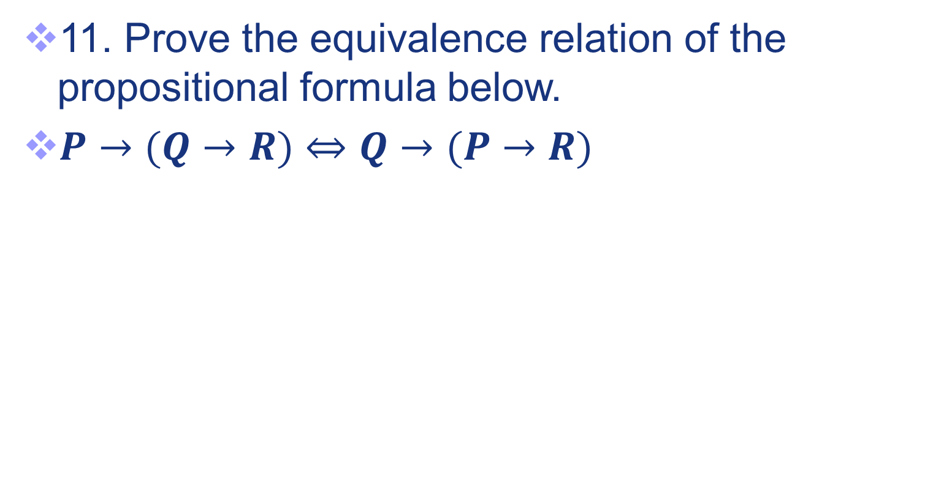
Exercises
10.
61

Slide 62
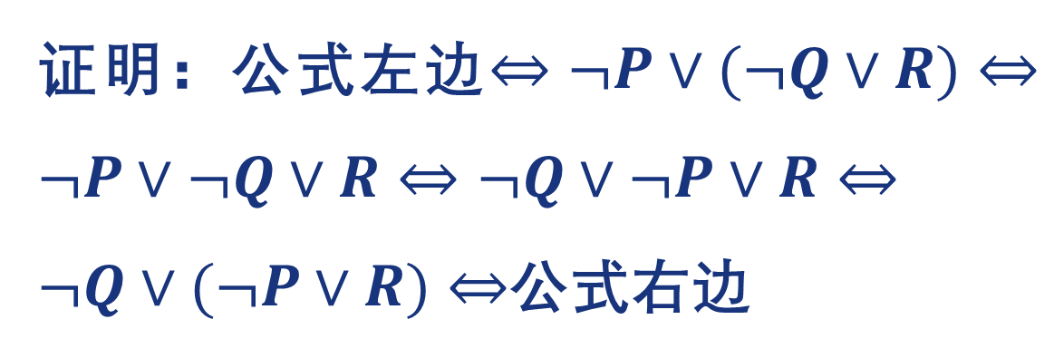
Exercises
10.
62

Slide 63
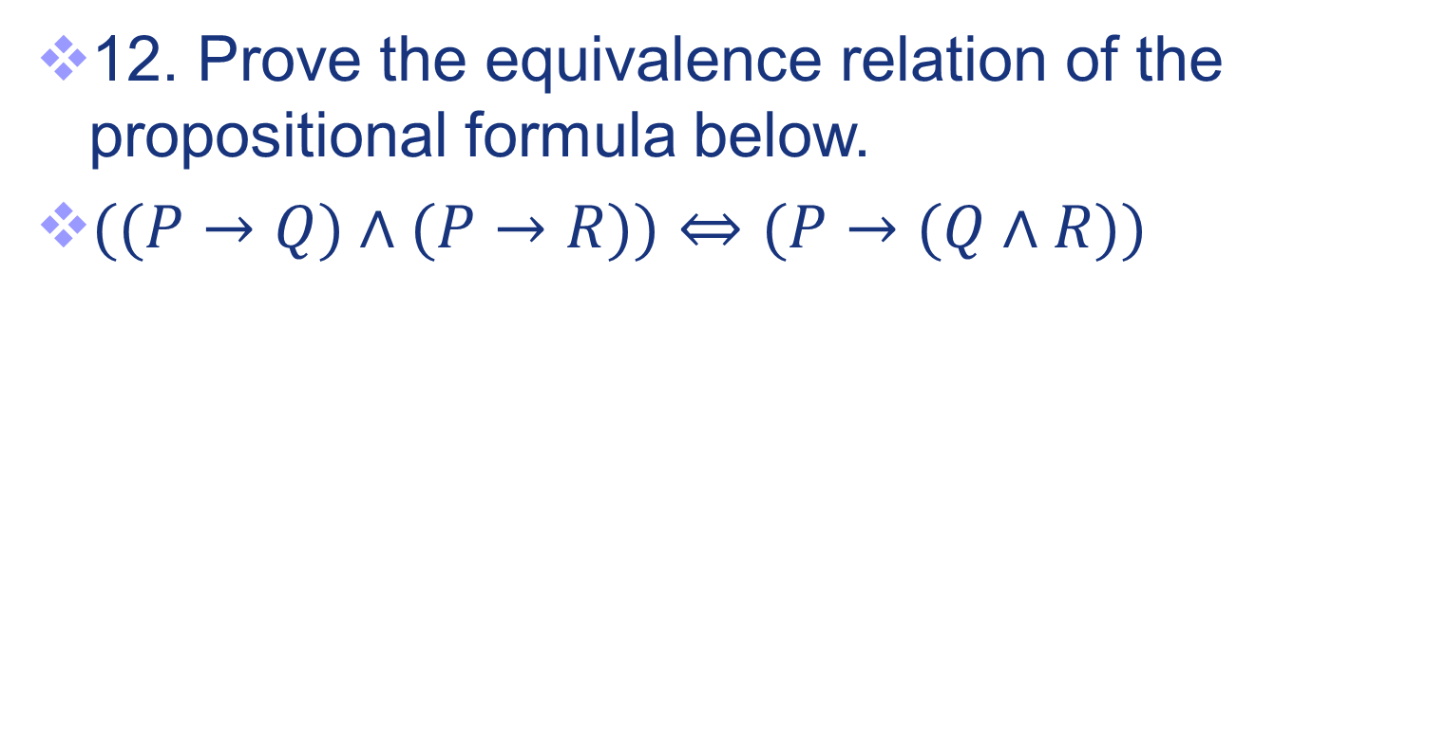
Exercises
11.
63

Slide 64
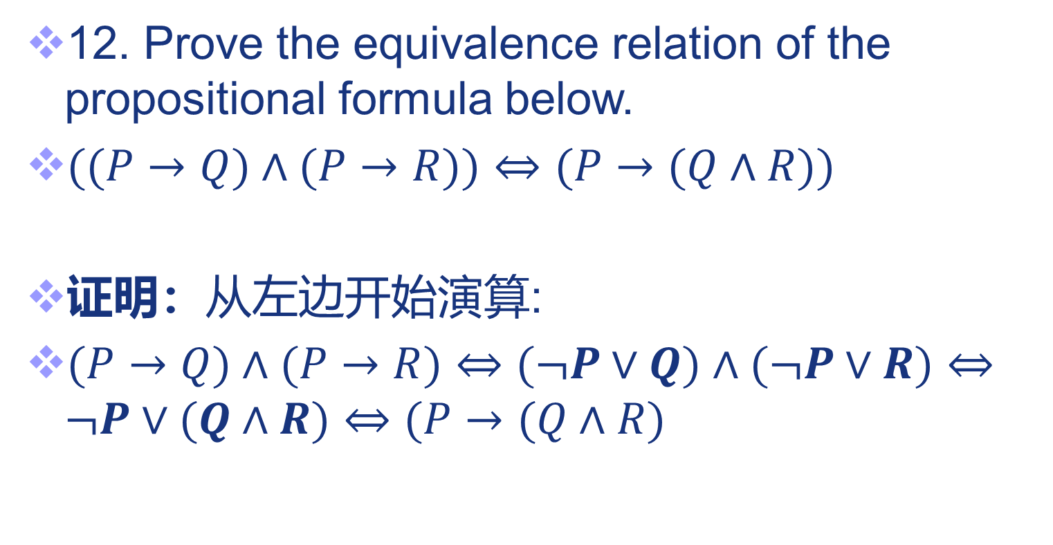
Exercises
11.
64

Slide 65
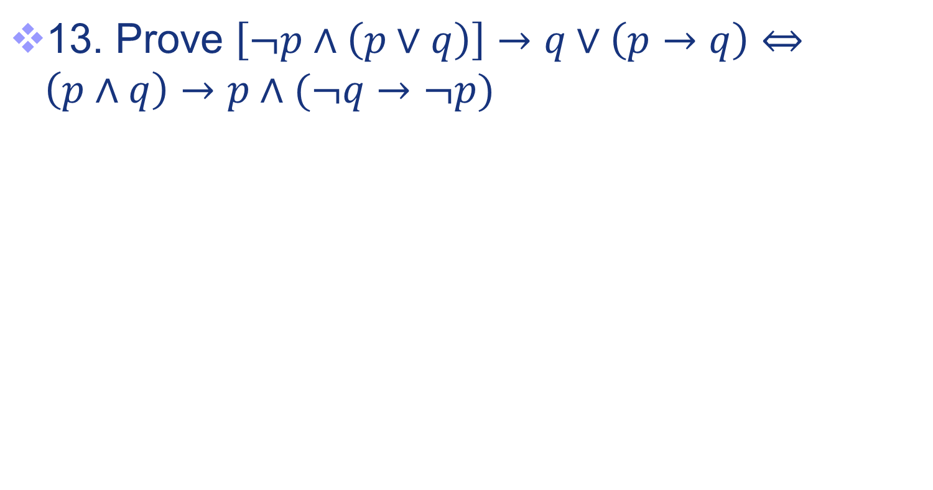
Exercises
11111
12.
65

Slide 66
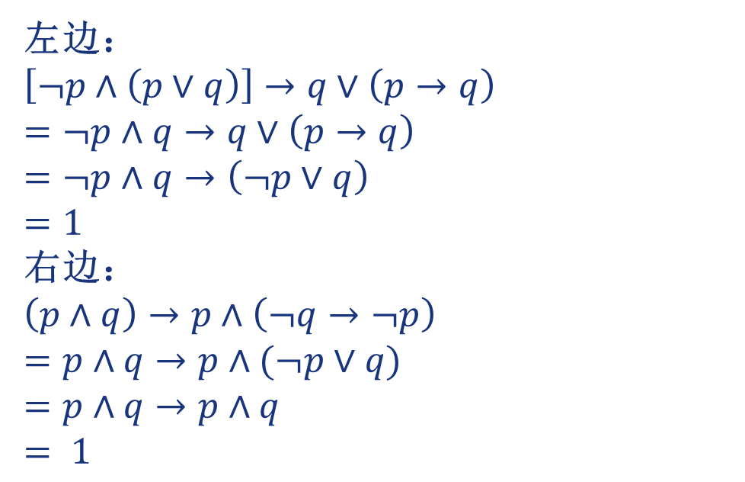
Exercises
11111
12.
66

Slide 67
Exercises
13. Use equivalences to prove that (p ∧ ¬q) → (p ⊕ r) ⇔ ¬p ∨ q ∨ ¬r.
67

Slide 68
Exercises
13. Use equivalences to prove that (p ∧ ¬q) → (p ⊕ r) ⇔ ¬p ∨ q ∨ ¬r.
Proof.
(p ∧ ¬q) → (p ⊕ r) [Expand “definition” of →]
⇔ ¬(p ∧ ¬q) ∨ (p ⊕ r) [Expand “definition” of ⊕]
⇔ ¬(p ∧ ¬q) ∨ ((p ∨ r) ∧ ¬(p ∧ r)) [DeMorgan]
⇔ (¬p ∨ q) ∨ ((p ∨ r) ∧ ¬(p ∧ r))
⇔ (q ∨ ¬p) ∨ ((p ∨ r) ∧ ¬(p ∧ r)) [∨ is associative]
⇔ q ∨ (¬p ∨ ((p ∨ r) ∧ ¬(p ∧ r))) [distrib. ∨ over ∧]
⇔ q ∨ (((¬p ∨ (p ∨ r)) ∧ (¬p ∨ ¬(p ∧ r))) [assoc.]
68

Slide 69
Exercises
13.
q ∨ (((¬p ∨ (p ∨ r)) ∧ (¬p ∨ ¬(p ∧ r))) [assoc.]
q ∨ (((¬p ∨ p) ∨ r) ∧ (¬p ∨ ¬(p ∧ r))) [taut.]
q ∨ ((T ∨ r) ∧ (¬p ∨ ¬(p ∧ r))) [domination]
q ∨ (T ∧ (¬p ∨ ¬(p ∧ r))) [identity]
⇔ q ∨ (¬p ∨ ¬(p ∧ r))
⇔ q ∨ (¬p ∨ (¬p ∨ ¬r)) [Assoc.]
⇔ q ∨ ((¬p ∨ ¬p) ∨ ¬r) [Idempotent]
⇔ q ∨ (¬p ∨ ¬r) [Associativity]
⇔ (q ∨ ¬p) ∨ ¬r [Commutativity]
⇔ ¬p ∨ q ∨ ¬r
69

Slide 70

Exercises
14. Prove that $(p→q)→¬(p∧¬q)$ is a tautology.
70

Slide 71
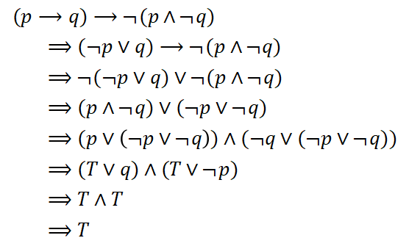
Exercises
14. Prove that $(p→q)→¬(p∧¬q)$ is a tautology.
71

Slide 72
Exercises
15. A, B, C and D are workers of a company. A job requires two of them to accomplish. According to the following statements, how many job assignment solutions can you have? How do you assign the job?
72

Slide 73
Exercises
15. A, B, C and D are workers of a company. A job requires two of them to accomplish. According to the following statements, how many job assignment solutions can you have? How do you assign the job?
If A takes the job, either C or D should take the job too.
B and C cannot be assigned with the job at the same time.
If C is assigned with the job, D will not take the job.
73

Slide 74
Exercises
15. Proof.
A→C⊕D，¬(B∧C)，C→¬D必须同时成立
(A→C⊕D)∧¬(B∧C)∧(C→¬D)
⇔(¬A∨(C∧¬D)∨(¬C∧D))∧(¬B∨¬C)∧(¬C∨¬D)使用分配律
⇔(¬A∨(C∧¬D)∨(¬C∧D))∧((¬B∧¬C)∨(¬B∧¬D)∨¬C∨(¬C∧¬D))使用分配律
⇔(¬A∧¬B∧¬C)∨(¬A∧¬B∧¬D)∨(¬A∧¬C)∨(¬A∧¬C∧¬D)∨(C∧¬D∧¬B∧¬C)∨(C∧¬D∧¬B∧¬D)∨(C∧¬D∧¬C)∨(C∧¬D∧¬C∧¬D)∨(¬C∧D∧¬B∧¬C)∨(¬C∧D∧¬B∧¬D)∨(¬C∧D∧¬C)∨(¬C∧D∧¬C∧¬D)
74

Slide 75
Exercises
15.
<=>F∨F∨(¬A∧¬C)∨F∨F∨(C∧¬D∧¬B)∨F∨F∨(¬C∧D∧¬B)∨F∨(¬ C∧D)∨F
<=>(¬ A∧¬C)∨(¬ B∧C∧¬D)∨(¬C∧D∧¬B)∨(¬ C∧D)
<=>(¬ A∧¬C)∨(¬ B∧C∧¬D)∨(¬C∧D) <=>T 故有三种派法：B∧D，A∧C，A∧D。
75

Slide 76
End of the Section 1.2
76

